Slide 1
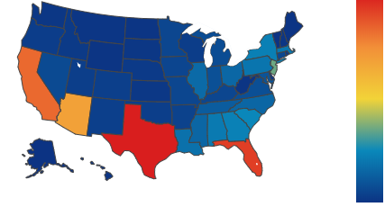
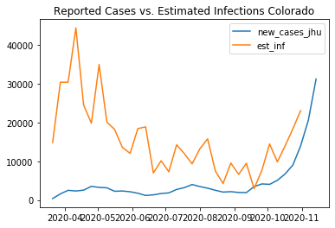
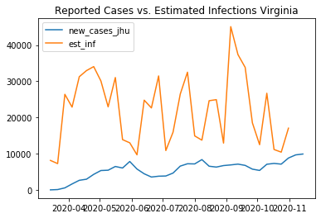
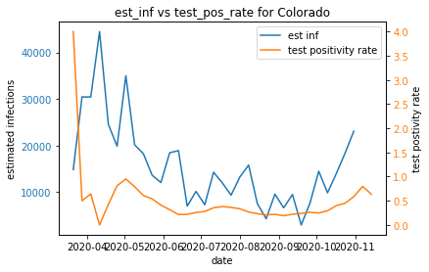
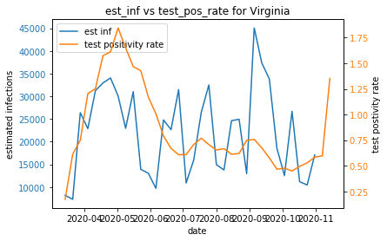
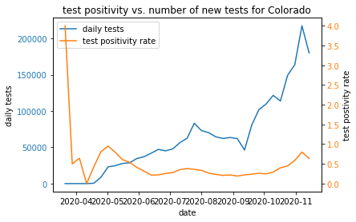
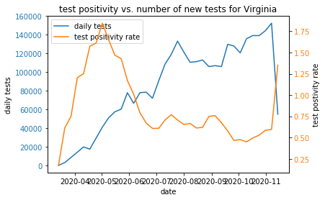
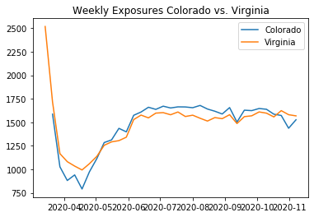
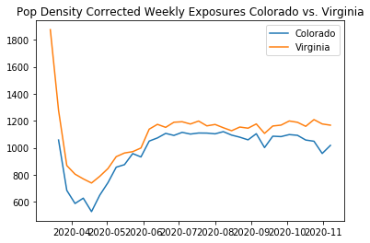
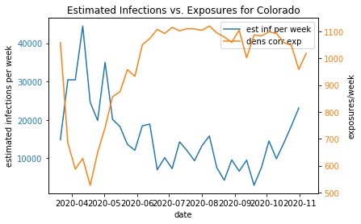
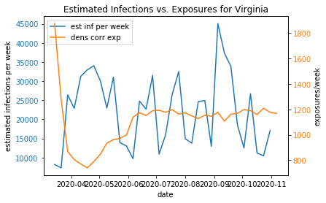
Latest date of entry in JHU data 2020-11-14
New Infections/100k
% of Population Infected to Date
14.2%
Estimated total percent of the US population that has been infected by COVID-19 as of 2020-10-31
2.8%
Reported total percent of the US population that has been infected by COVID-19 as of 2020-10-31: 2.8%
Link to table with the percent of the population of each state that has been infected to date
Choose states for comparison graphs
State 1
State 2

